Slide 1

Business Intelligence to Maximize profit through Product Selection
Pamela Chakrabarty

Slide 2
Business Scenario
Goals
Objective:
Make recommendations for increasing company’s profits
Analyze the sales data and identify trends
Build customer-friendly end-to-end business intelligence system
Gain insights on current sales strategy
Prioritize marketing efforts for targeted products
Discontinue products that are not profitable
Limitations:
2 years of sales data is not enough to make a solid recommendation
No access to customers

Slide 3

Deliverables
Business intelligence system that integrates cross-functional data
Interactive Dashboard that tracks Key Performance Indicators (KPI) and business metrics
Recommendations to enhance profitability

Slide 4

Product Profitability and Sales

Slide 5
Main Analysis Parameters
Sales Profit Margin
Sales Profit
Sales Quantity
Year
Day of the week

Slide 6
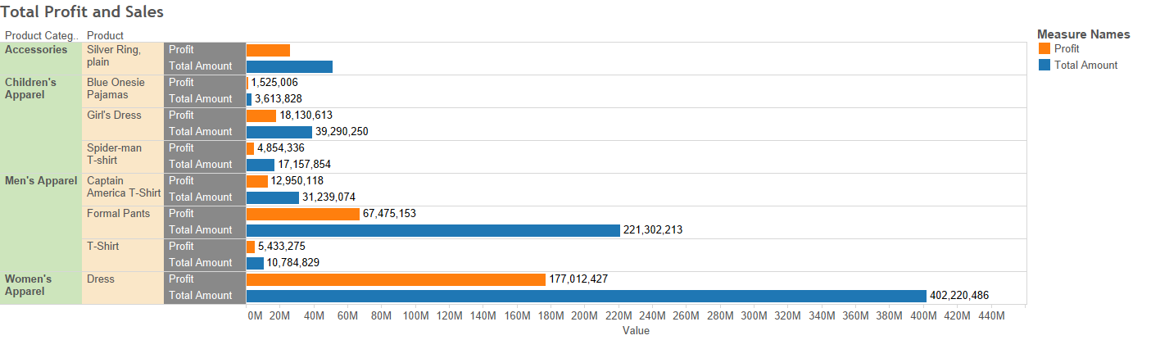
Product Analysis: Total Sales and Profit
1
2
3
Blue Onesie Pajamas, Spider-man T-Shirt, Captain America T-Shirts

Slide 7
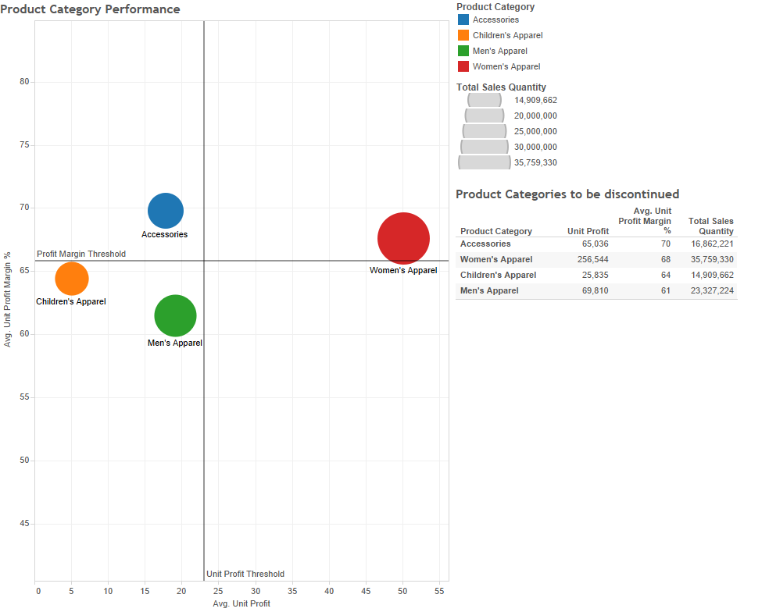
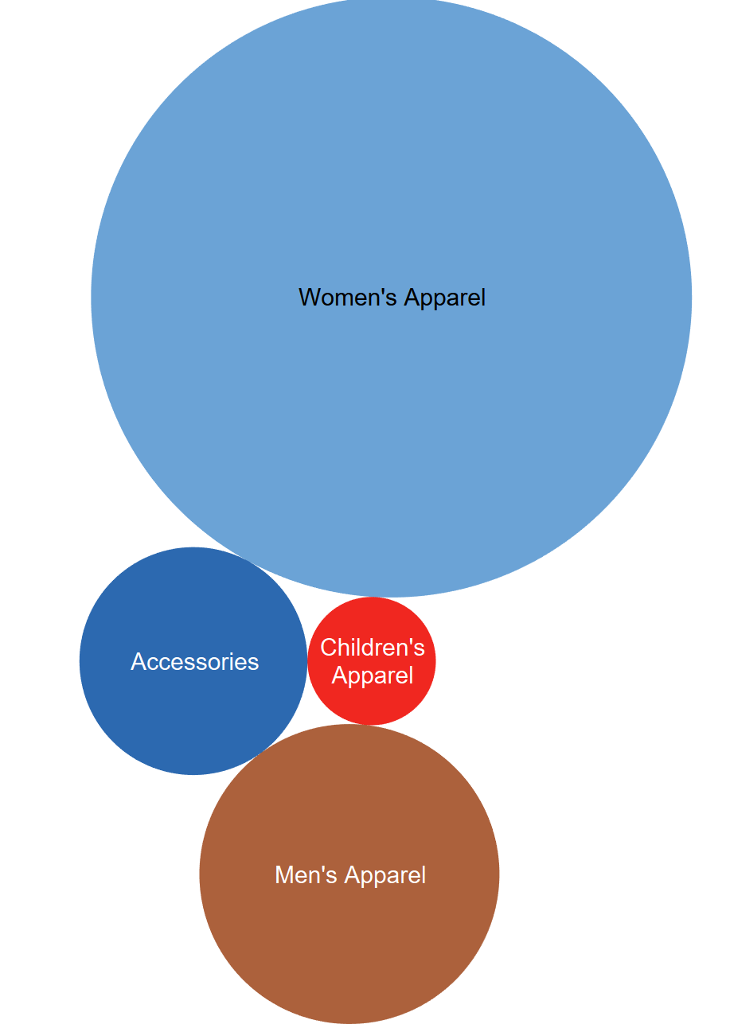
Product Category Profitability

Slide 8
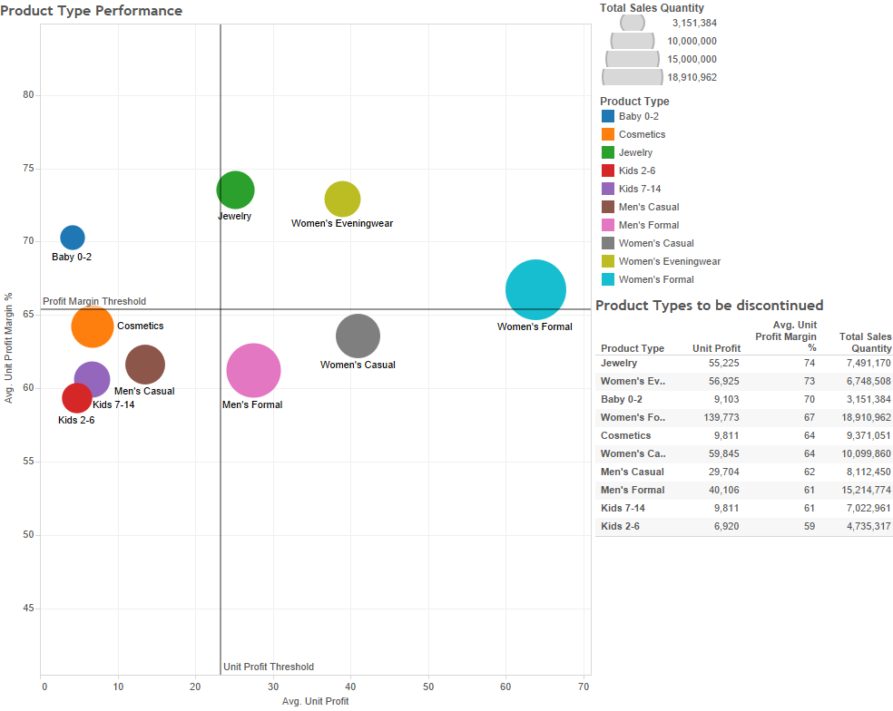
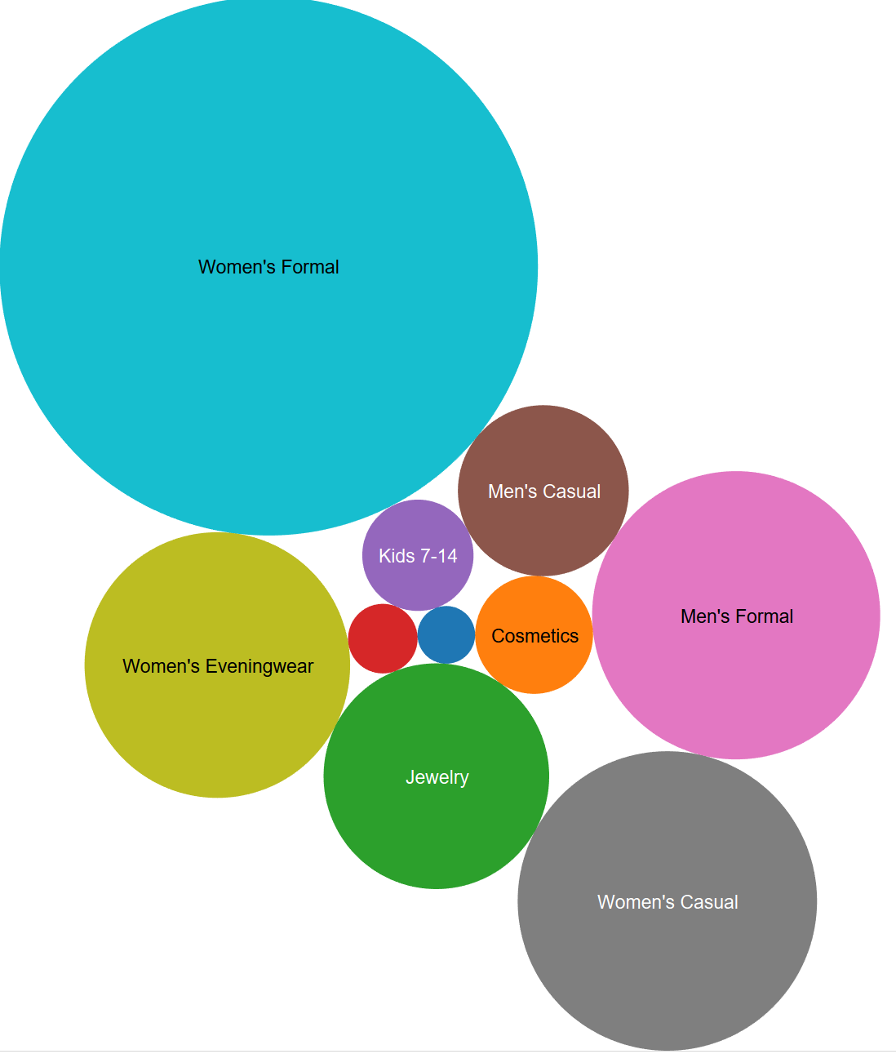
Product Type Profitability

Slide 9
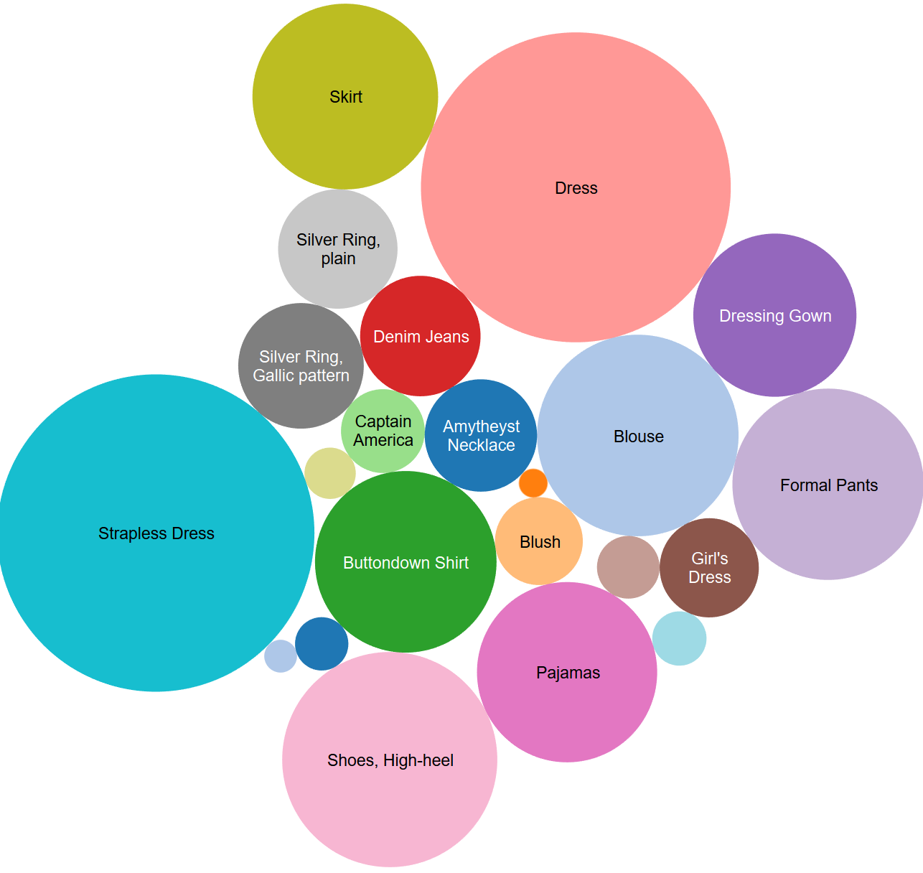
Product Profitability
Low Profitability:
Blue Onesie Pajamas
Captain America T-shirt
White Socks
Thomas the Train Pajamas
T-Shirt
Silver Ring, plain
Spider-Man T-Shirt
Lipstick

Slide 10
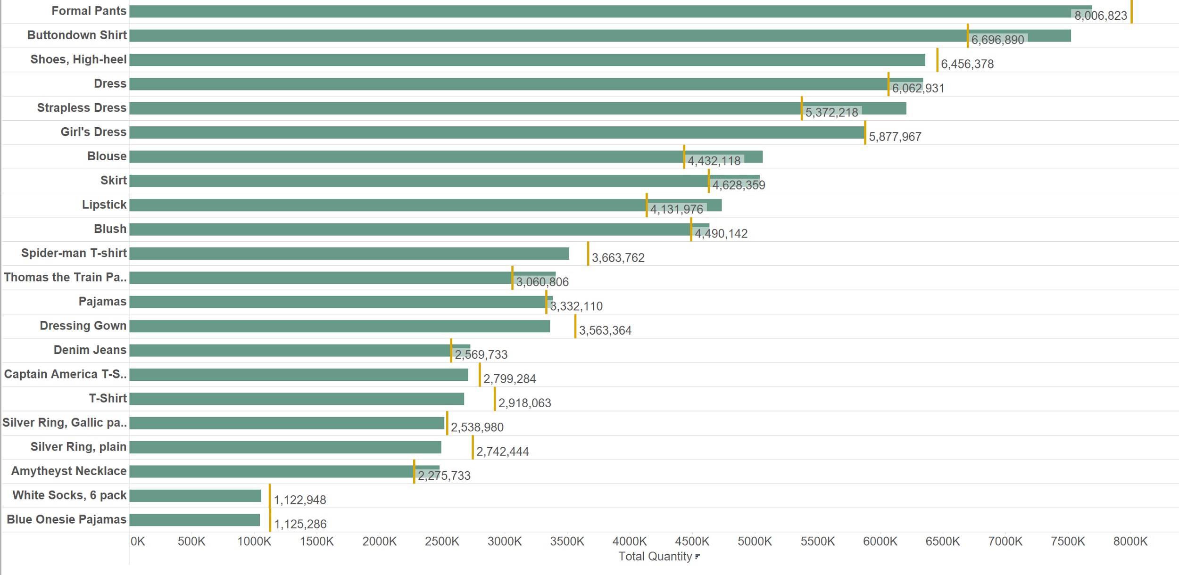
Current Sales vs. Target Sales
Missed Target:
Formal Pants
Shoes, High-heel
Spider-man T-shirt
Dressing Gown
T-Shirt
Silver Ring, plain
Silver Ring, pattern
White Socks
Blue Onesie Pajamas
Captain America T-shirt
Notes:
Blue onsie pajama 2.Spiderman 3. Girl’s dress in children 4. t-shirt 5. Captain america T-shirt 6. T shirt

Slide 11
Product Sales and Profit by Weekday

Slide 12
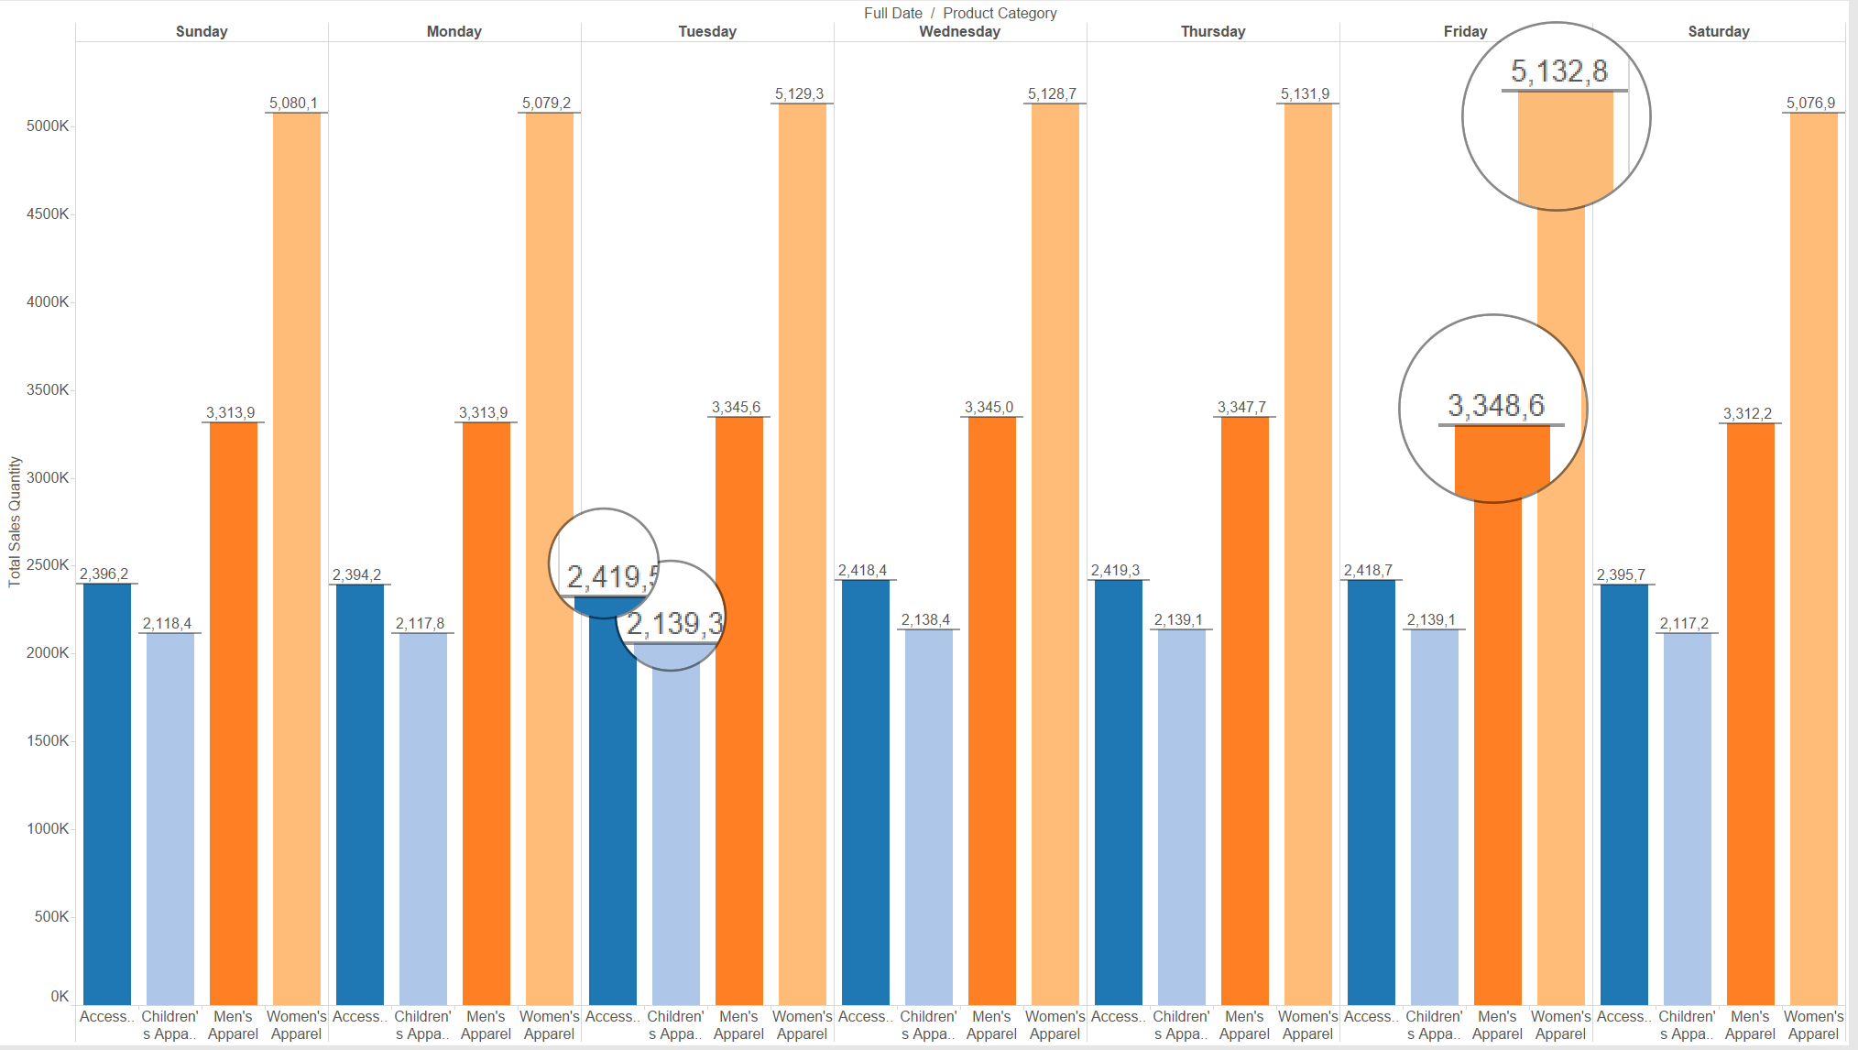
Sales Quantity by Day of the Week
Observations:
1. Women’s Apparel, Men’s Apparel sold more on Fridays
2. Accessories and Children’s Apparel sold more on Tuesdays

Slide 13
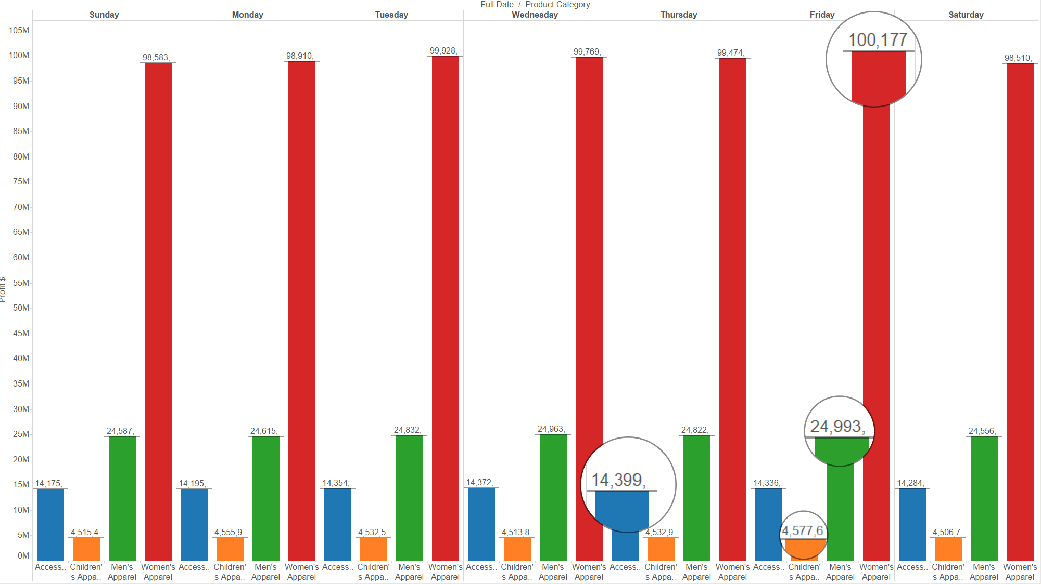
Sales Profit by day of week
Observations:
1. Women’s Apparel, Men’s Apparel and Children’s Apparel made more profit on Fridays
2. Accessories gathered more profit on Thursdays

Slide 14
Product Performance Over Time

Slide 15
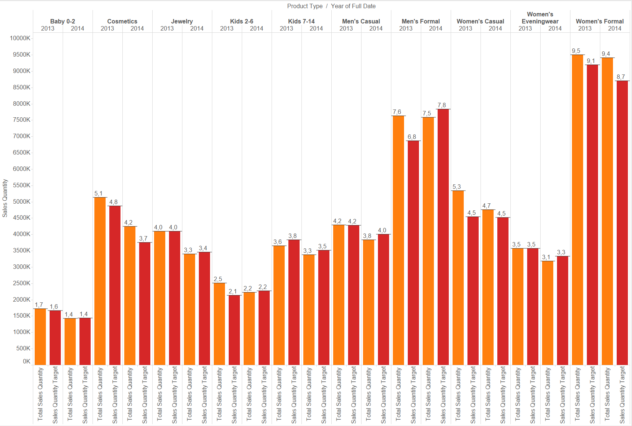
Products Types in 2013 Vs. 2014
Observations:
1. Cosmetics, Women’s Casual and Women’s Formal has met target in both 2013 and 2014

Slide 16
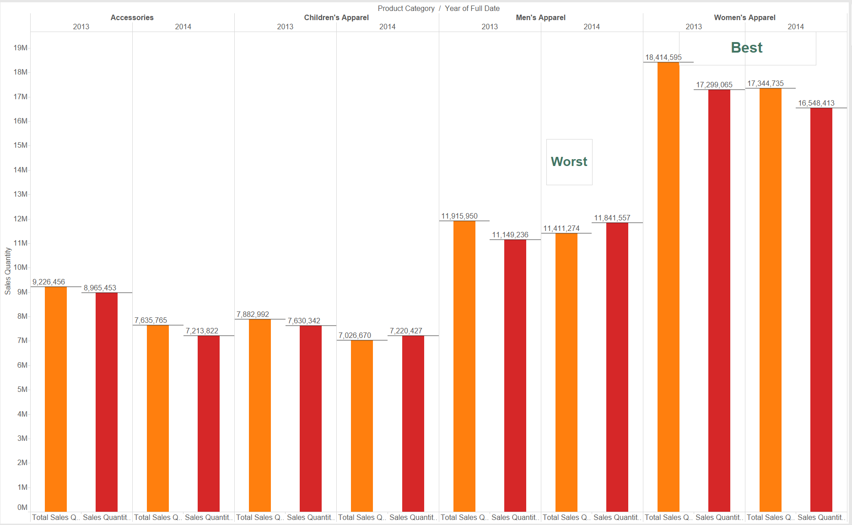
Product Category in 2013 Vs. 2014
Women’s Apparel met target sales in both years
Men’s apparel did not meet the target 430283 quantity

Slide 17

Recommendations

Slide 18
Recommendations :
Promote products during peak time of the week, focusing on specific customer groups and product segments
Days of the week:
Fridays:
Men, Women
Tuesdays/Thursdays: Children and Accessories
Discontinue product lines that fail to meet target and generate low profitability
Products:
Spiderman T-Shirt, Silver Ring Plain, White Socks, Blue Onesie Pajamas, Captain America T-Shirt
Allocate resources to products that have high growth rate or profitability and do not meet their targets
Products:
Formal Pants, High Heels, Dressing Gown
Evaluate potential price increments for products that have met target sales but generate low profits
Price Increments:
Denim Jeans, Blush

Slide 19

Thank You! Questions?

